Slide 1

Sea Breeze Interactions with Aerosol Content and Boundary Layer Structure in the Coastal Houston Region
Isaac Medina
Energy Meteorology – EN.530.637

Slide 2

MOTIVATION
SB have long been correlated with days of higher pollution rates, suppressed mixing and a lowering of the Atmospheric Boundary Layer (ABL) height (Miller et al. 2003).
Houston, TX is a large coastal city with a large industrial sector and lots of natural gas energy generation.
Using Data from the 2022 Tracing Aerosol Convection Interactions Experiment (TRACER) Campaign
Houston metro area
1
Miller, S. T. K., B. D. Keim, R. W. Talbot, and H. Mao, 2003: Sea breeze: Structure, forecasting, and impacts. Reviews of Geophysics, 41 (3), 2003RG000 124, doi:10.1029/2003RG000124
Donoghoe, M., and A. Perry, 2023: How Cities Should Compensate Residents for Toxic Exposure. Bloomberg.com, September 8.

Slide 3

SEA BREEZE BASICS
Gulf of Mexico
Houston
La Porte – ARM AFM1
Texas, U.S.
S
W
E
N
Area of interest; Coastal Texas/ Houston metro area
2

Slide 4
SEA BREEZE BASICS
Unequal heating between land and gulf drive the thermally direct Sea Breeze (SB) circulation
Daytime Warming
Solar heating begins; land heats up quicker than the gulf
2

Slide 5
SEA BREEZE BASICS
L
Unequal heating between land and gulf drive the thermally direct Sea Breeze (SB) circulation
H
Unequal heating begets the formation of a pressure gradient favoring on-shore flow
H
L
SB pressure gradients driving mesoscale circulation
2

Slide 6
SEA BREEZE BASICS
Unequal heating between land and gulf drive the thermally direct Sea Breeze (SB) circulation
Unequal heating begets the formation of a pressure gradient favoring on-shore flow
SB Passage quantified by:
Wind direction shift
Decrease in surface temperature
Increase in water vapor
With SB passage we expect:
(Physick and Byron-Scott 1977; Miller et al. 2003)
Increasing Surface Stability
Suppression of Vertical Mixing
Decreasing CBL Height
Increasing Surface Aerosol Content
Sea Breeze forms and pushes on land bringing cooler, moist air
2
Physick, W. L., and R. a. D. Byron-Scott, 1977: Observations of the sea breeze in the vicinity of a gulf. Weather, 32 (10), 373–381, doi: 10.1002/j.1477-8696.1977.tb04481.x,
Miller, S. T. K., B. D. Keim, R. W. Talbot, and H. Mao, 2003: Sea breeze: Structure, forecasting, and impacts. Reviews of Geophysics, 41 (3), 2003RG000 124, doi:10.1029/2003RG000124

Slide 7

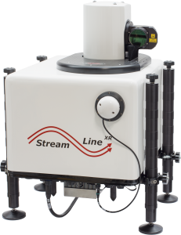
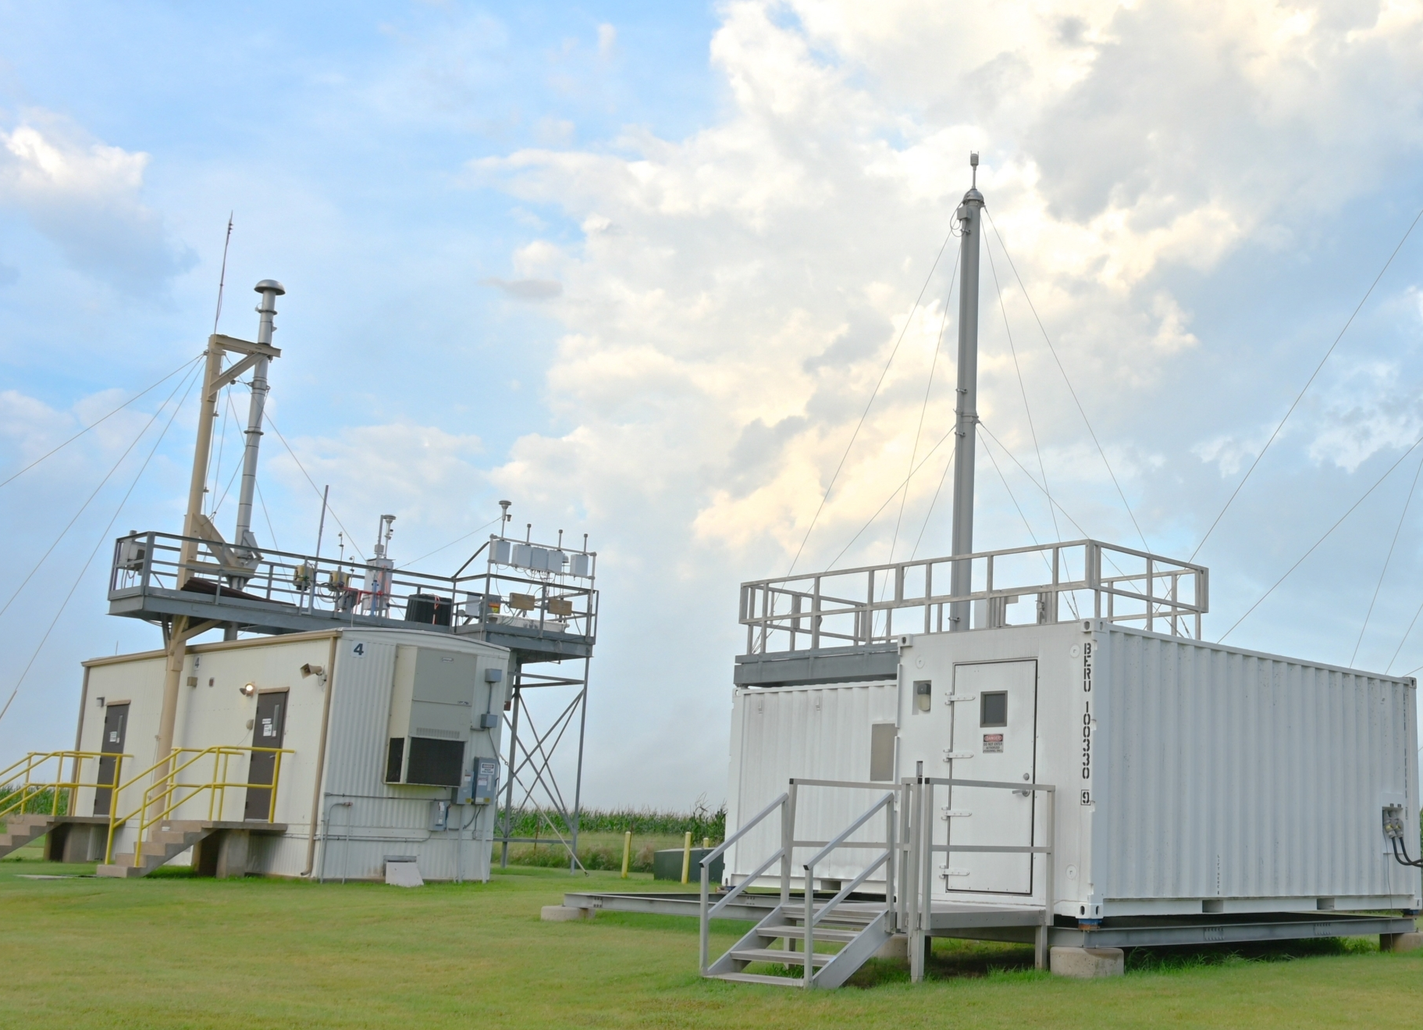
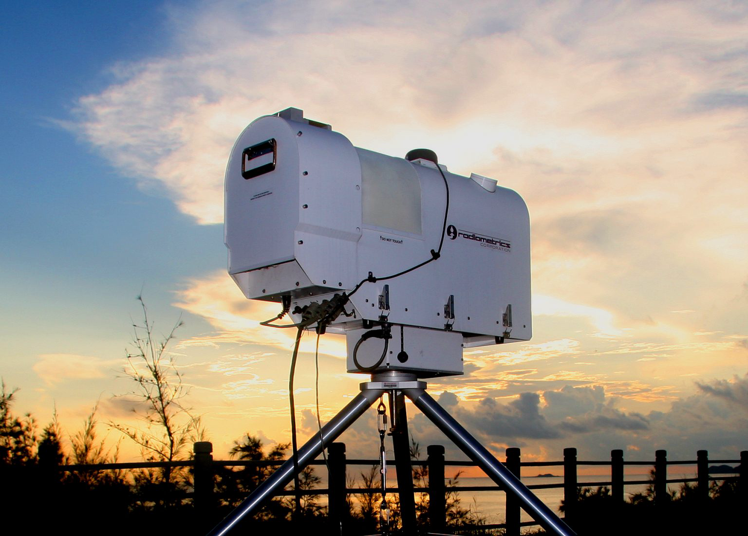
DATA SOURCING
TRACER Campaign Data – ARM AFM1 Site in La Porte, TX
Aerosol Content Data
Wind Speed/ Direction Data
Temperature / Water Vapor Data
Atmospheric Radiation Measurement Aerosol Observing System (AOS)
Radiometrics – Microwave Radiometer
https://radiometrics.com/radiometers/
Halo Photonics – Streamline Lidar
https://www.arm.gov/capabilities/instruments/aos
https://halo-photonics.com/lidar-systems/streamline-allsky-series/
3
Notes:
From AOS were using the condensation particle counters with the finer 2.5nm threshold

Slide 8
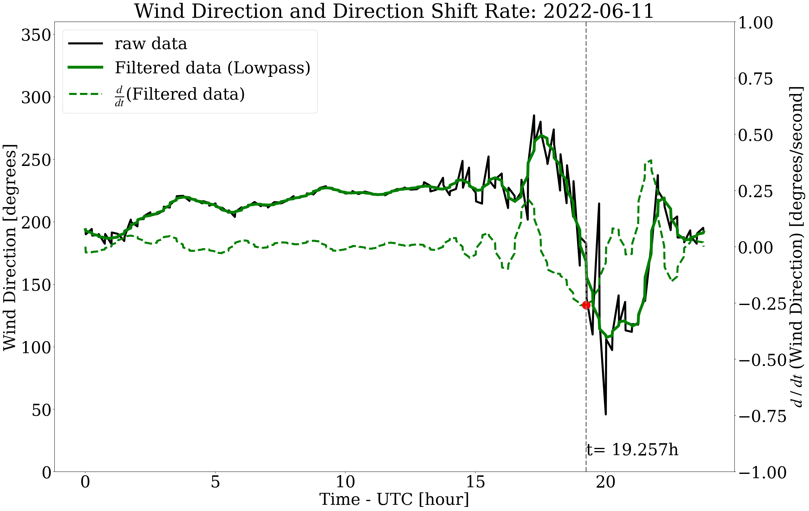

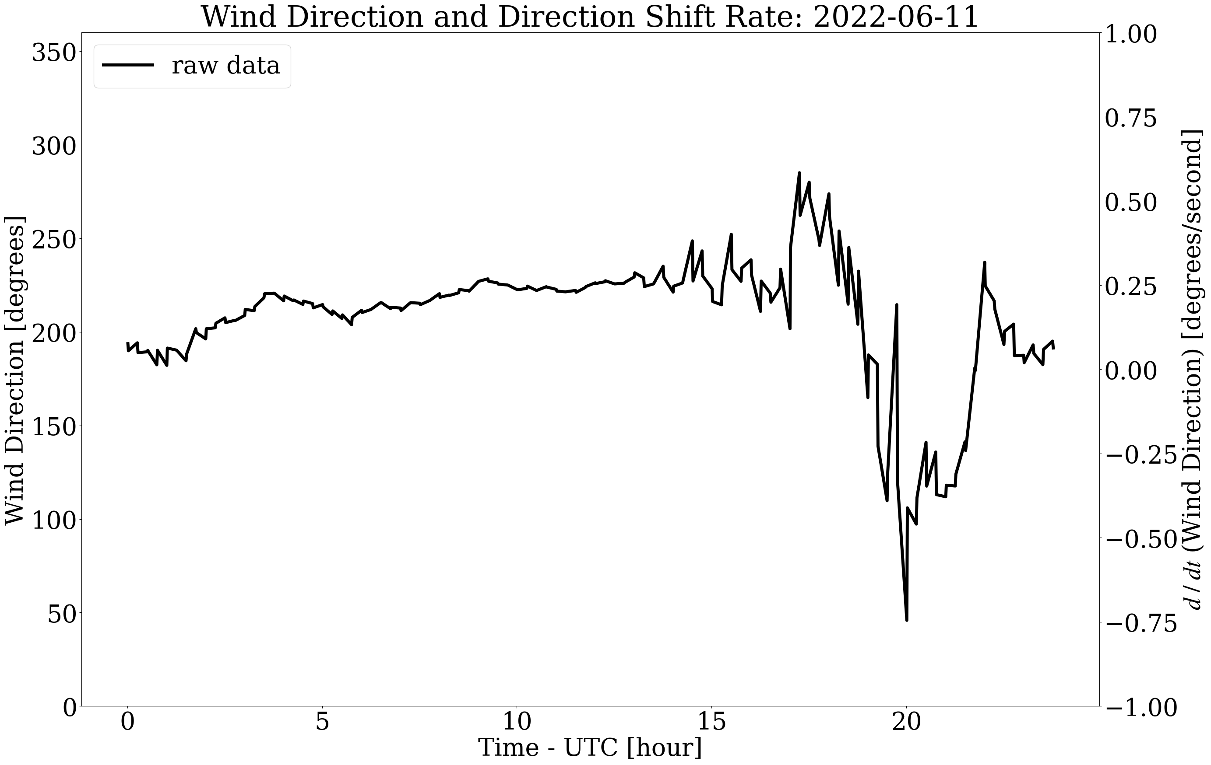
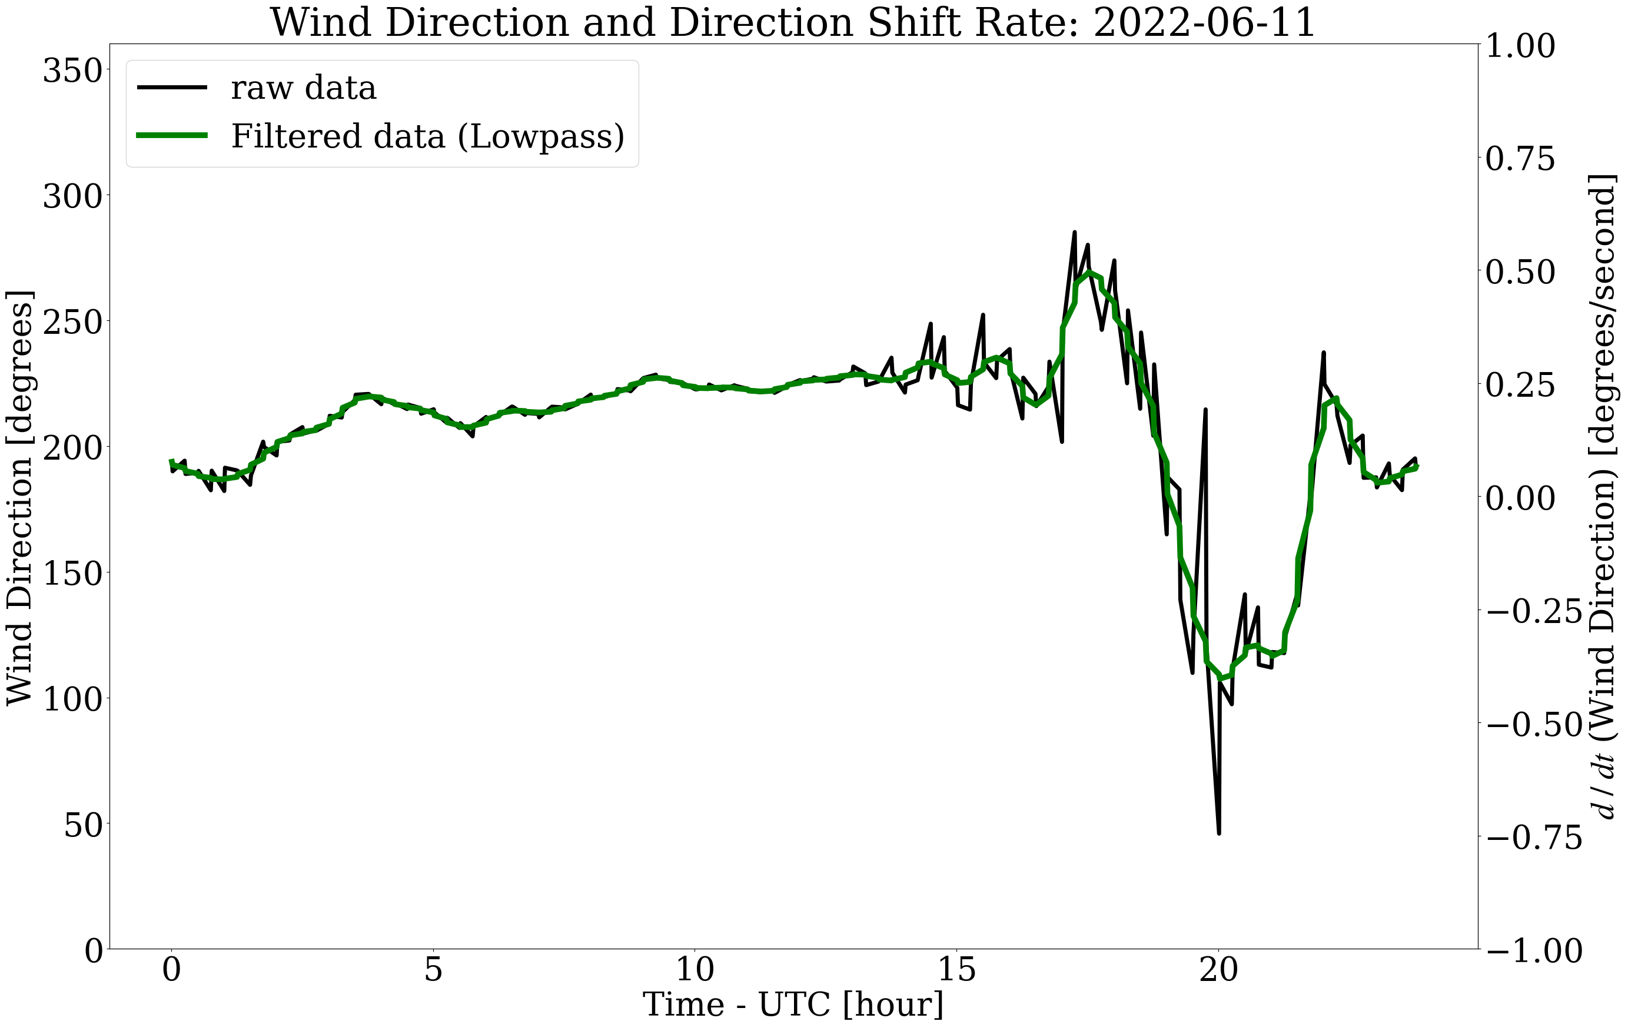
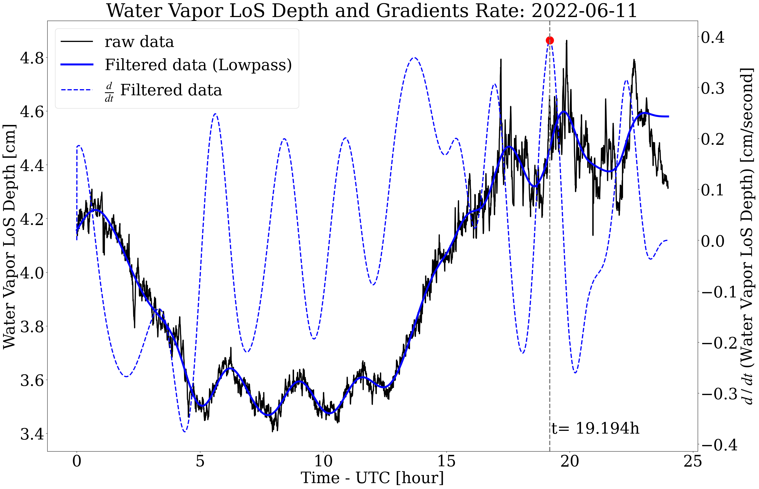
SB IDENTIFICATION
The SB is identified as a wind shift to shore perpendicular (ESE for La Porte), and an increase in water vapor.
While decreases in temperature are also common SB identifiers, Lappin et al. (2025) identified a lack of correlation with SB passage and temperature decreases and are therefore not used here.
4
Lappin, F., T. Bell, P. Klein, and G. d. Boer, 2025: Quantifying the thermodynamic impacts on the atmospheric boundary layer due to the sea breeze in the coastal Houston region. Journal of Applied Meteorology and Climatology, 64 (6), doi:10.1175/JAMC-D-24-0203.1,

Slide 9
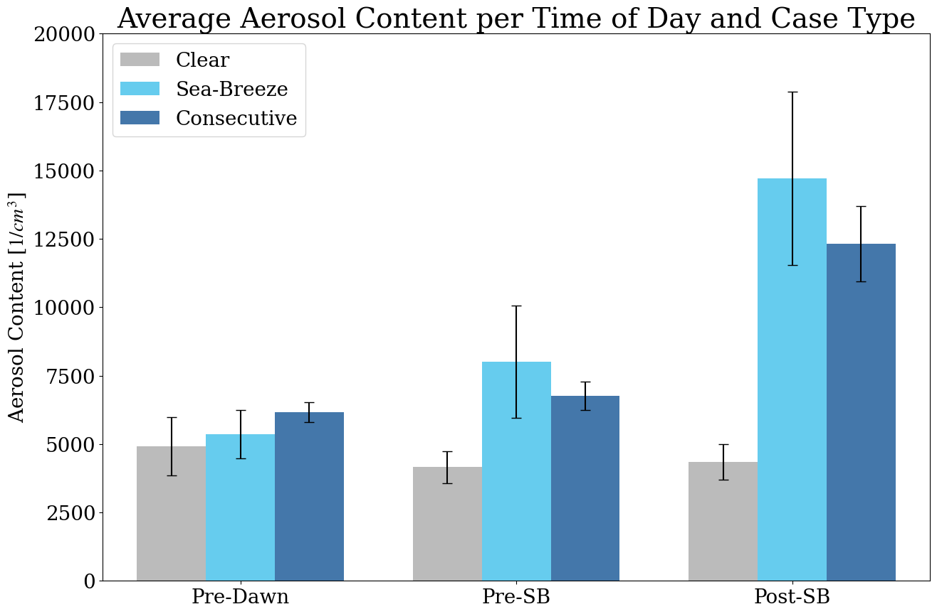
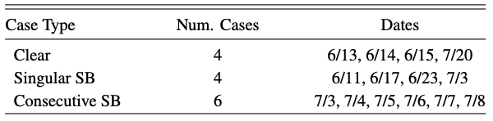
RESULTS
AEROSOL CONCETRATIONS
Case Days for Data Analysis
Aerosol content increases for both singular and consecutive SB cases post SB Passage.
Aerosol content increases more for singular cases, but with higher margins for error.
Aerosol content remains low and consistent for non-SB cases.
5

Slide 10
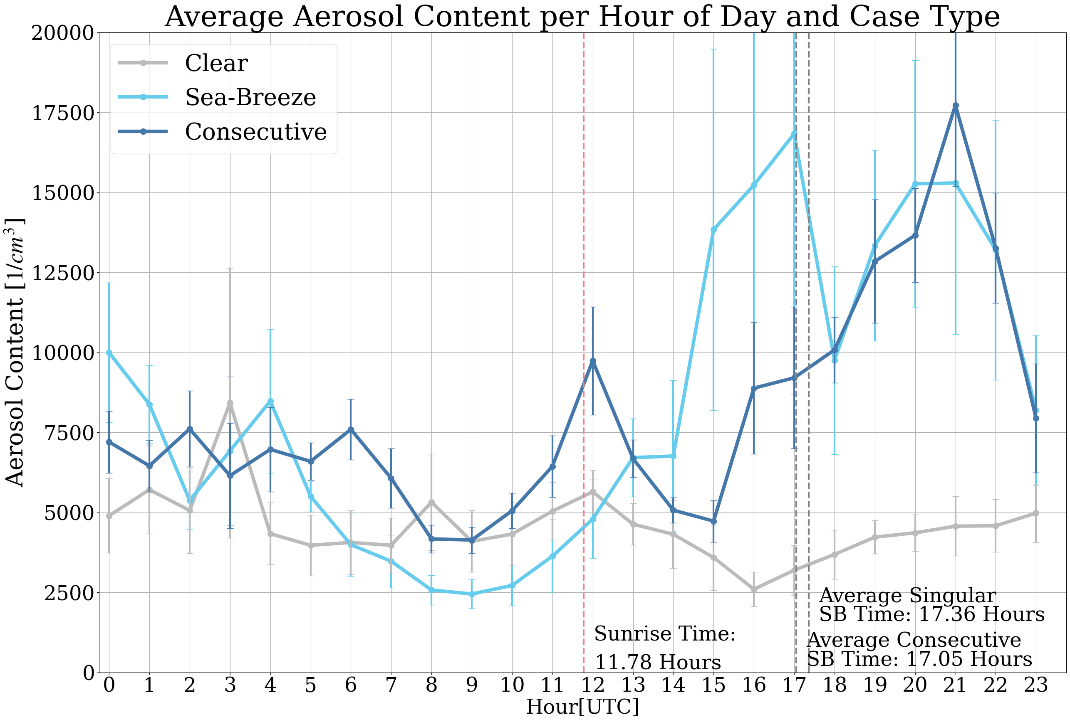
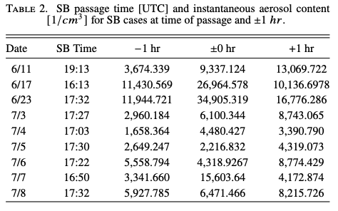
RESULTS
AEROSOLS BY THE HOUR
Aerosol content lowers after sunrise for clear cases, likely due to increased mixing
Consecutive SB days show a peak in aerosols at both SB passage time and sunrise
Singular SB cases appear to have a peak not at SB passage time; however, this is due to the wide spread in SB passage times in the observational period
6

Slide 11
RESULTS
AEROSOL CONCETRATIONS
Case Days for Data Analysis
Aerosol content increases for both singular and consecutive SB cases post SB Passage.
Aerosol content increases more for singular cases, but with higher margins for error.
Aerosol content remains low and consistent for non-SB cases.
5

Slide 12
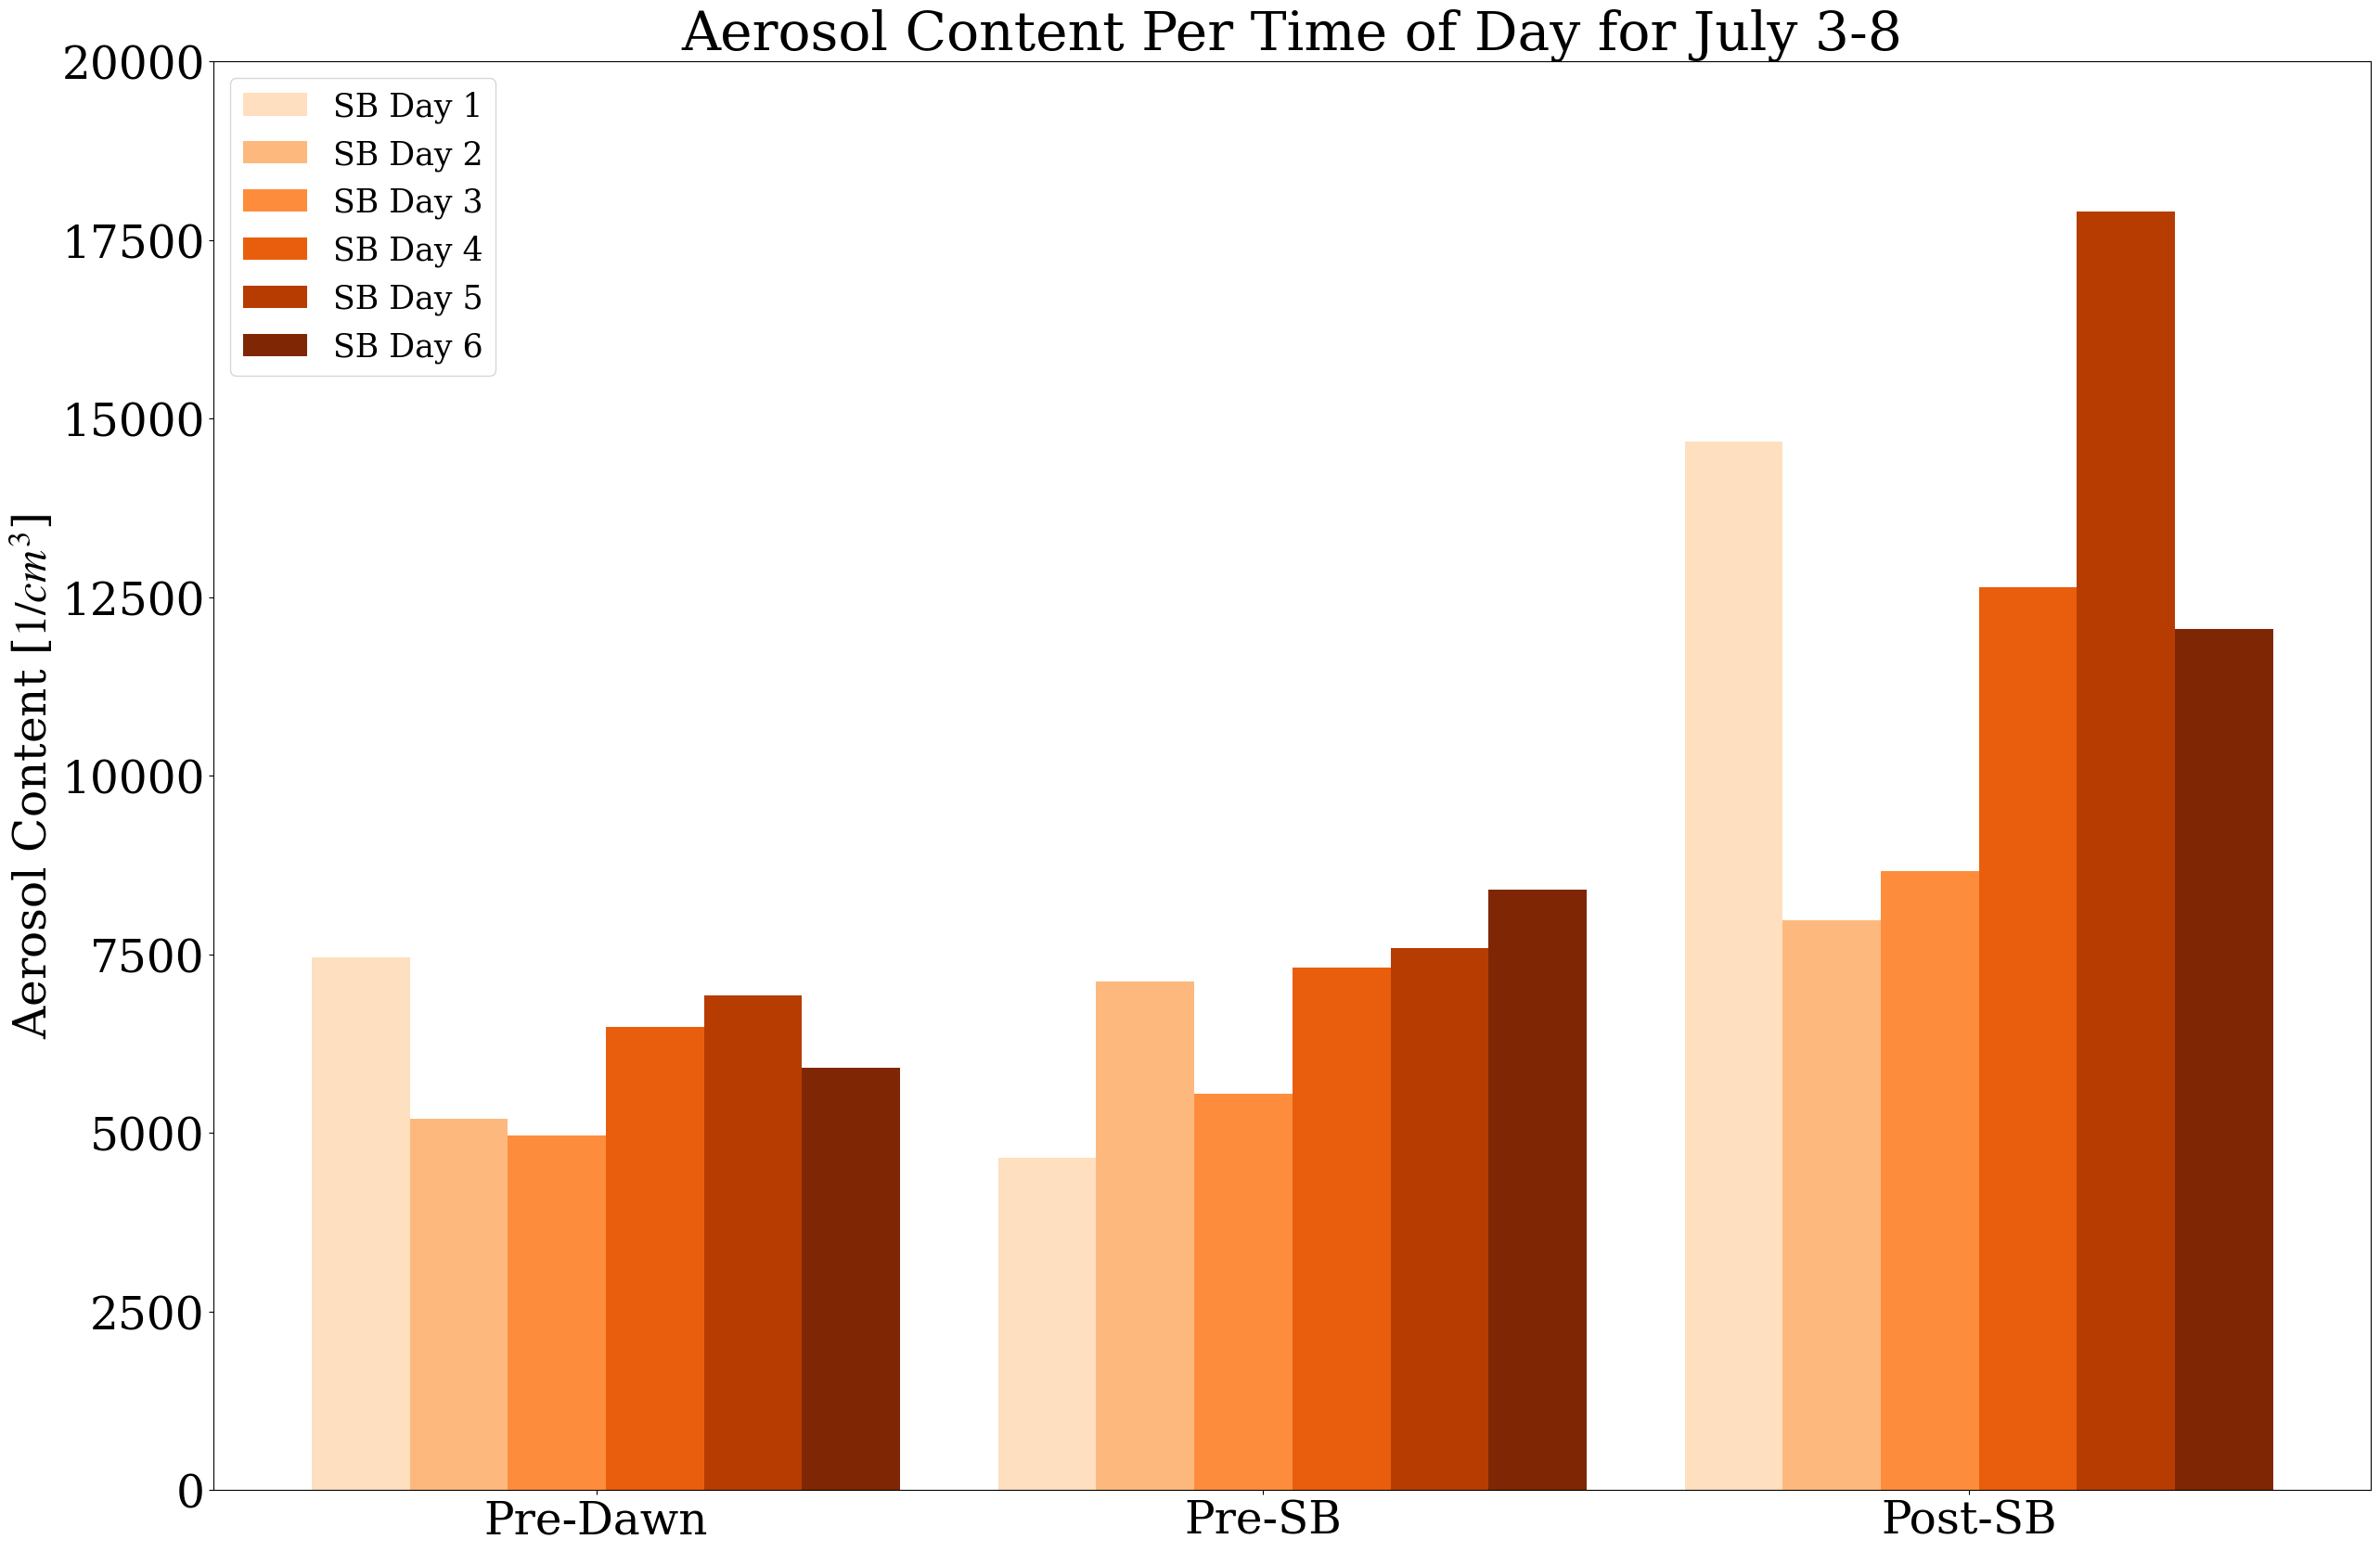
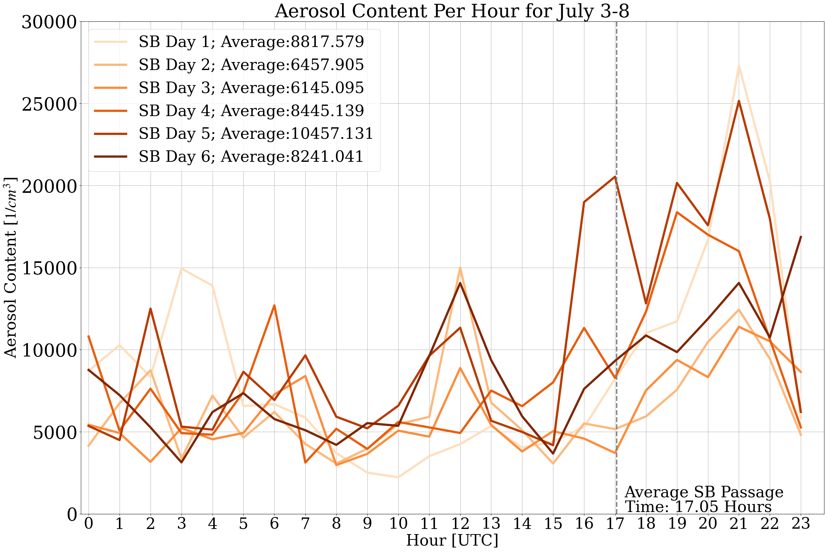
RESULTS
AEROSOL RECIRCULATION
General upward trend is observed, but it not consistently linear across observational period
Peak around sunrise is only present for days 2+
This may be caused by the increased likelihood for secondary aerosols to form during recirculation events (Talbot et al. 2007)
7
Talbot, C., P. Augustin, C. Leroy, V. Willart, H. Delbarre, and G. Khomenko, 2007: Impact of a sea breeze on the boundary-layer dynamics and the atmospheric stratification in a coastal area of the North Sea. Boundary Layer Meteorology, 125, 133–154.

Slide 13
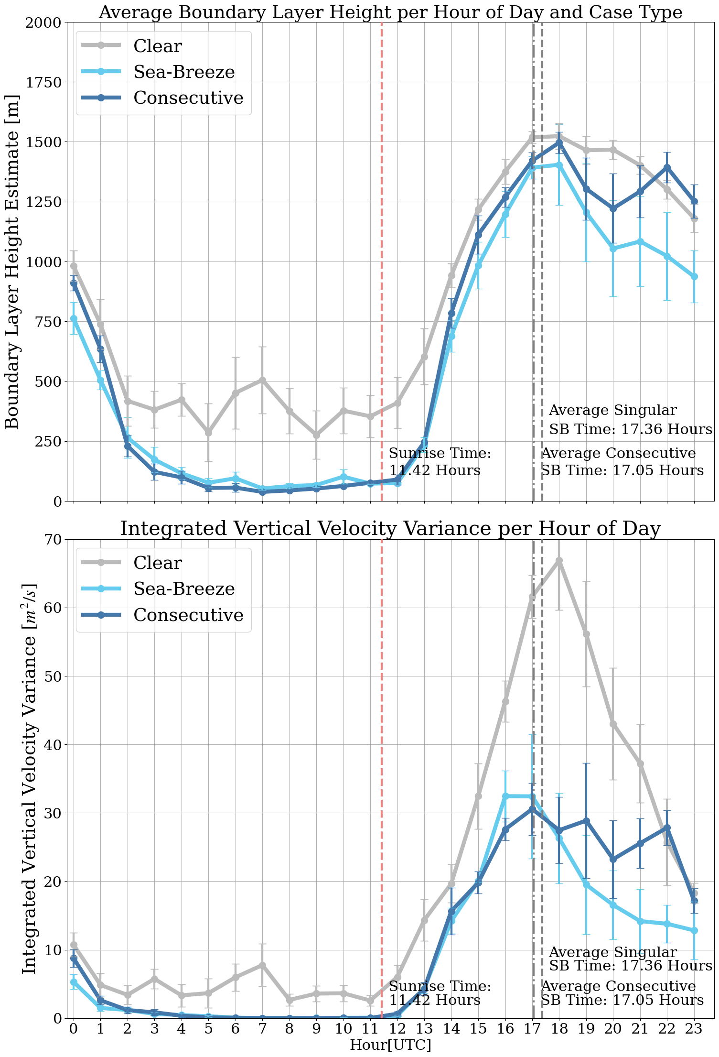
RESULTS
General decrease in CBL height with SB passage for both singular and consecutive cases.
Vertical velocity variance has been used as a measure of turbulent mixing during the CBL
ABL STRUCTURE
(Dewani et al. 2023)
A strong decrease in vertical velocity variance for days with a SB
Smith, E. N., and J. T. Carlin, 2024: A multi-instrument fuzzy logic boundary-layer-top detection algorithm. Atmospheric Measurement Techniques, 17, 4087–4107,
8
Dewani, N., M. Sakradzija, L. Schlemmer, R. Leinweber, and J. Schmidli, 2023: Dependency of vertical velocity variance on meteorological conditions in the convective boundary layer. Atmospheric Chemistry and Physics, 23, 4045–4058

Slide 14
SUMMARY
Aerosol content increases for both singular and consecutive SB cases post SB Passage.
Decreases in CBL height and boundary layer mixing also present post SB passage
Potential recirculation and secondary aerosol generation present during consecutive cases
9

Slide 15
REFERENCES
Dewani, N., M. Sakradzija, L. Schlemmer, R. Leinweber, and J. Schmidli, 2023: Dependency of vertical velocity variance on meteorological conditions in the convective boundary layer. Atmospheric Chemistry and Physics, 23, 4045–4058
Donoghoe, M., and A. Perry, 2023: How Cities Should Compensate Residents for Toxic Exposure. Bloomberg.com, September 8.
Lappin, F., T. Bell, P. Klein, and G. d. Boer, 2025: Quantifying the thermodynamic impacts on the atmospheric boundary layer due to the sea breeze in the coastal Houston region. Journal of Applied Meteorology and Climatology, 64 (6), doi:10.1175/JAMC-D-24-0203.1,
Miller, S. T. K., B. D. Keim, R. W. Talbot, and H. Mao, 2003: Sea breeze: Structure, forecasting, and impacts. Reviews of Geophysics, 41 (3), 2003RG000 124, doi:10.1029/2003RG000124
Physick, W. L., and R. a. D. Byron-Scott, 1977: Observations of the sea breeze in the vicinity of a gulf. Weather, 32 (10), 373–381, doi: 10.1002/j.1477-8696.1977.tb04481.x,
Smith, E. N., and J. T. Carlin, 2024: A multi-instrument fuzzy logic boundary-layer-top detection algorithm. Atmospheric Measurement Techniques, 17, 4087–4107,
Talbot, C., P. Augustin, C. Leroy, V. Willart, H. Delbarre, and G. Khomenko, 2007: Impact of a sea breeze on the boundary-layer dynamics and the atmospheric stratification in a coastal area of the North Sea. Boundary Layer Meteorology, 125, 133–154.
Instrument Figure Links:
ARM AOS: https://www.arm.gov/capabilities/instruments/aos
Lidar: https://halo-photonics.com/lidar-systems/streamline-allsky-series/
MWR: https://radiometrics.com/radiometers/
11

